Slide 2
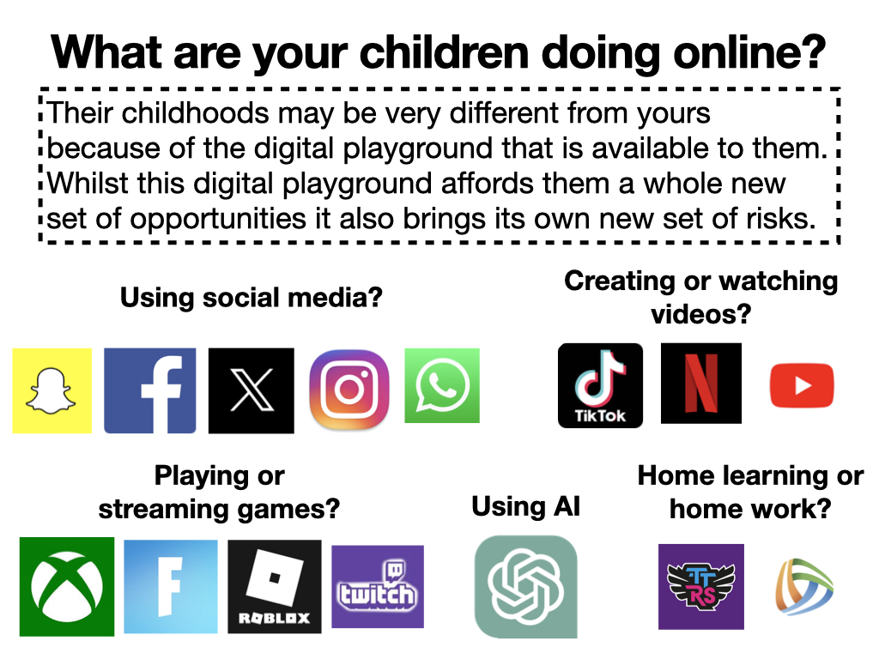

Slide 3
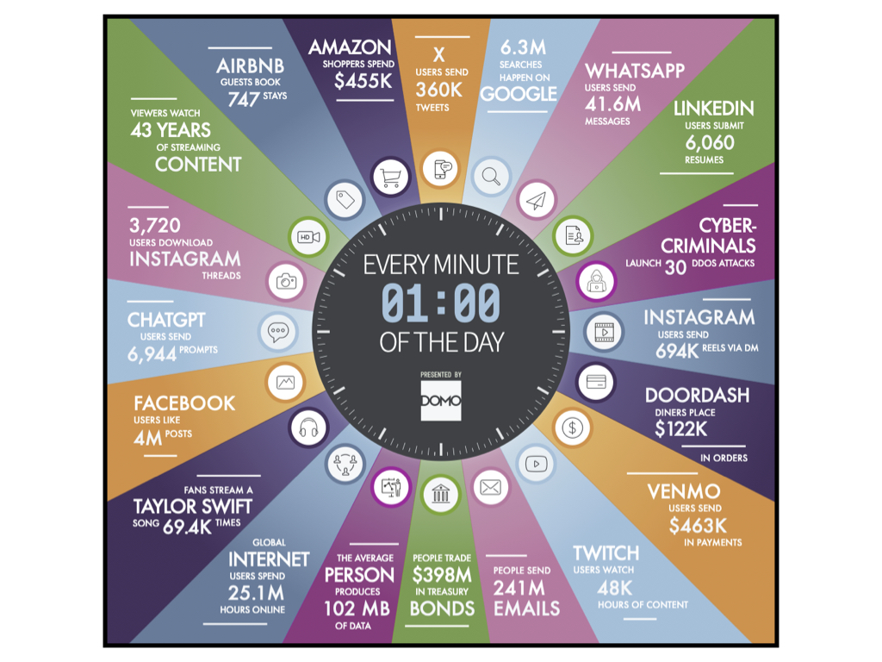

Slide 4
Via Ofcom children’s media use and attitudes report
https://www.ofcom.org.uk/siteassets/resources/documents/research-and-data/media-literacy-research/children/children-media-use-and-attitudes-2024/childrens-media-literacy-report-2024.pdf?v=368229

Slide 6
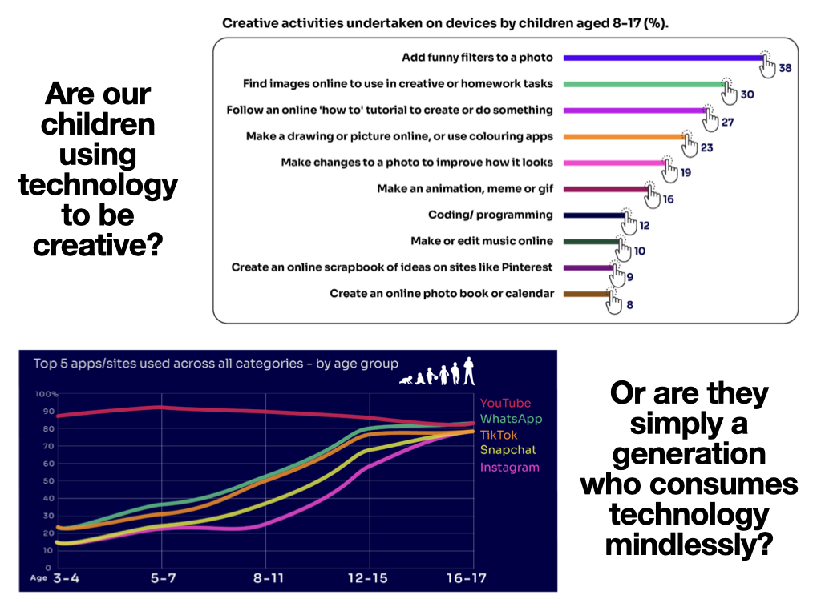

Slide 8
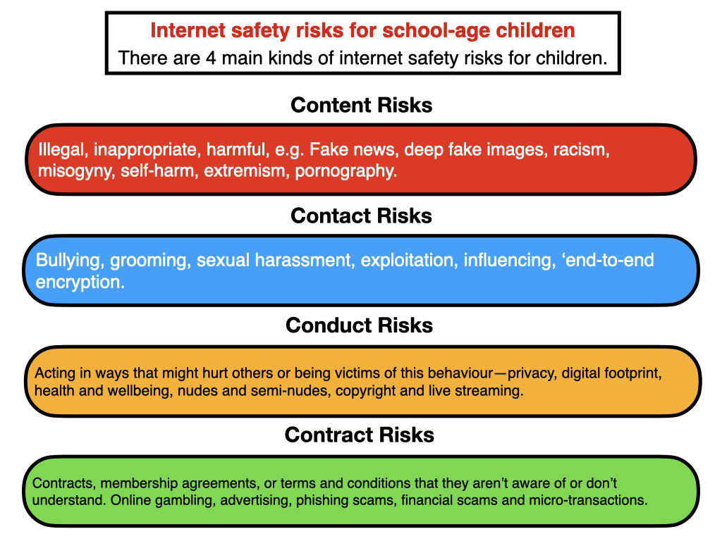

Slide 9
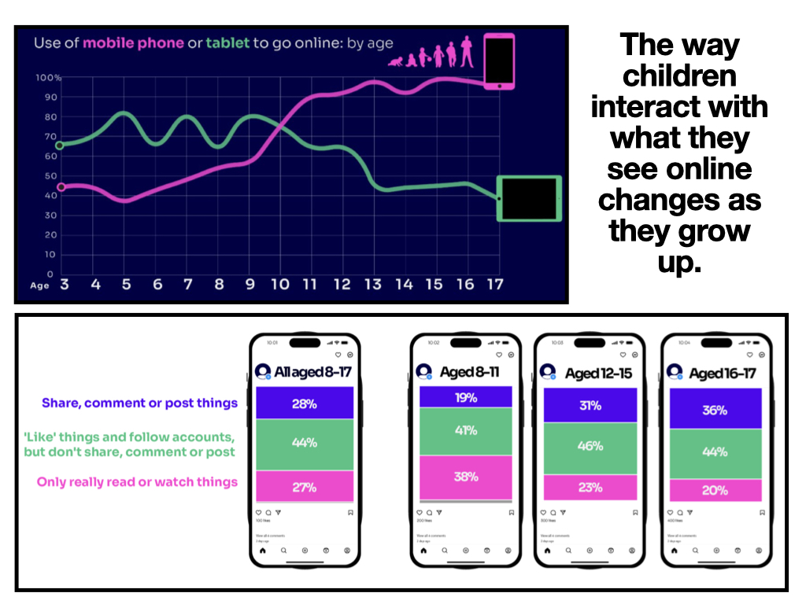

Slide 11
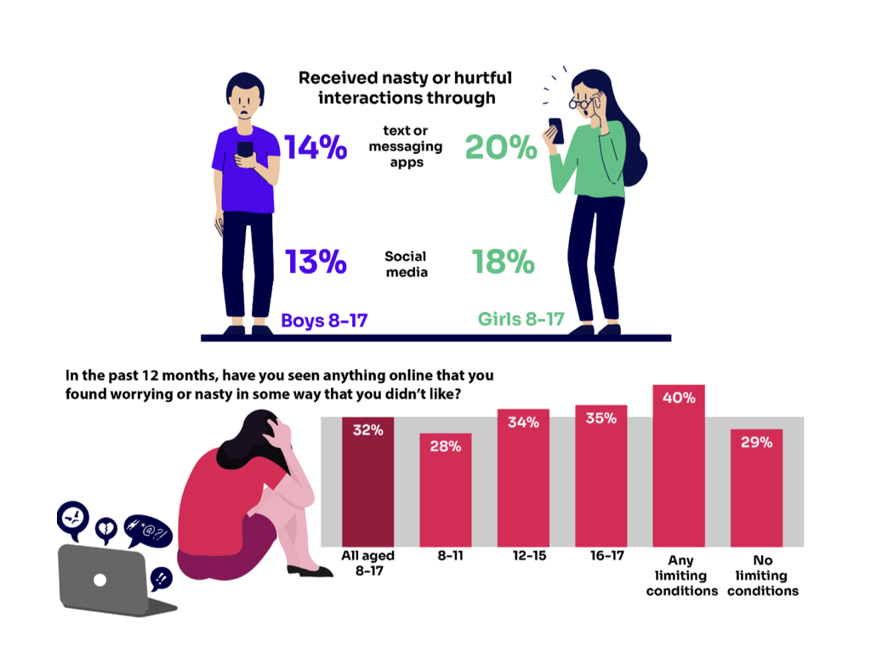

Slide 13
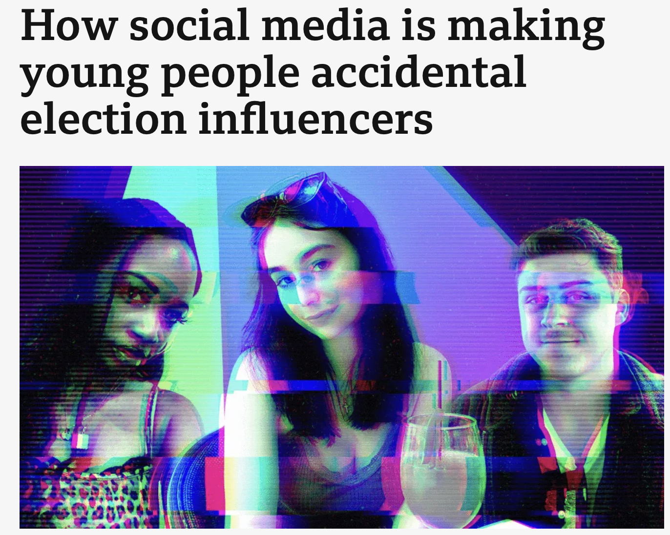
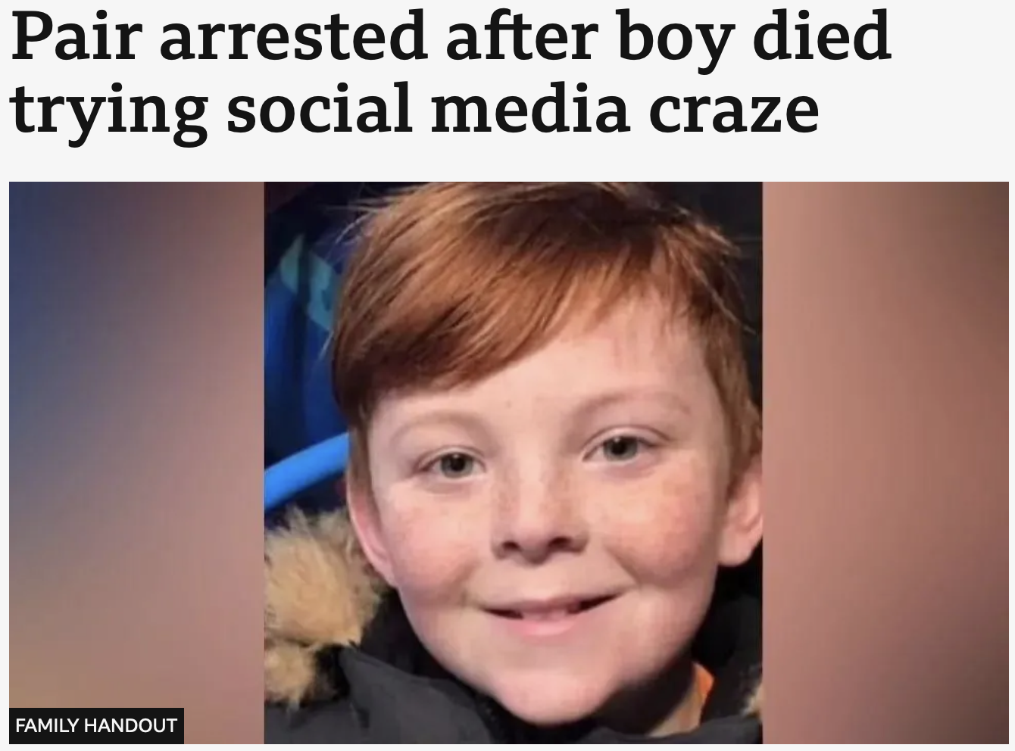
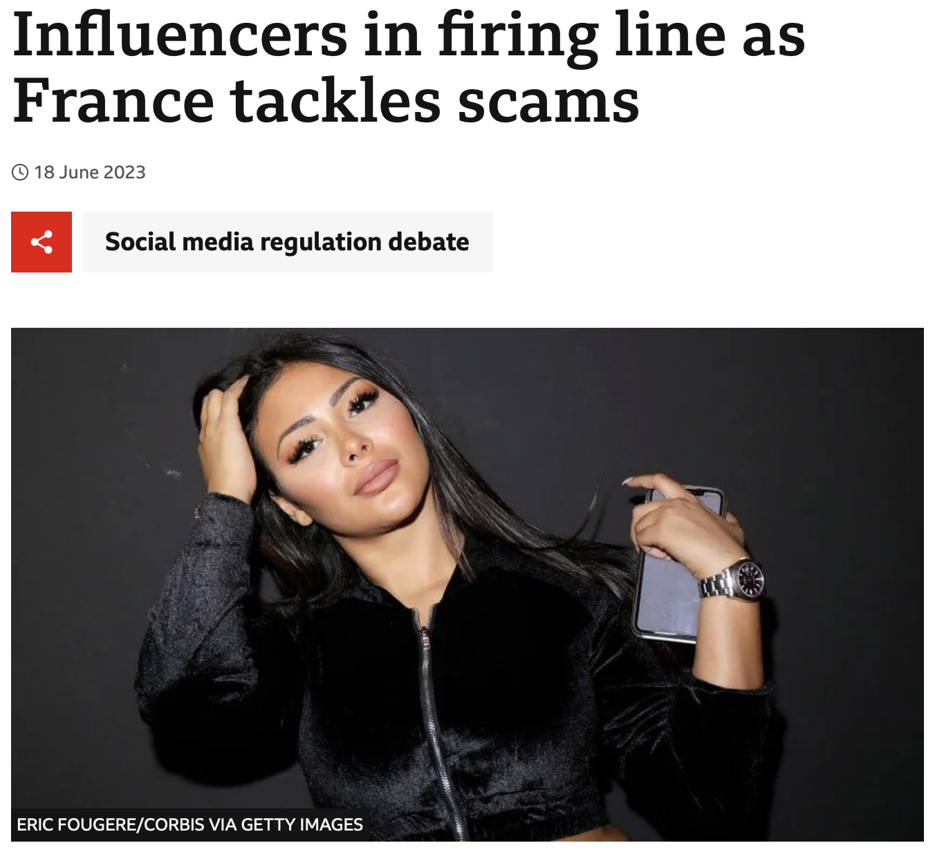
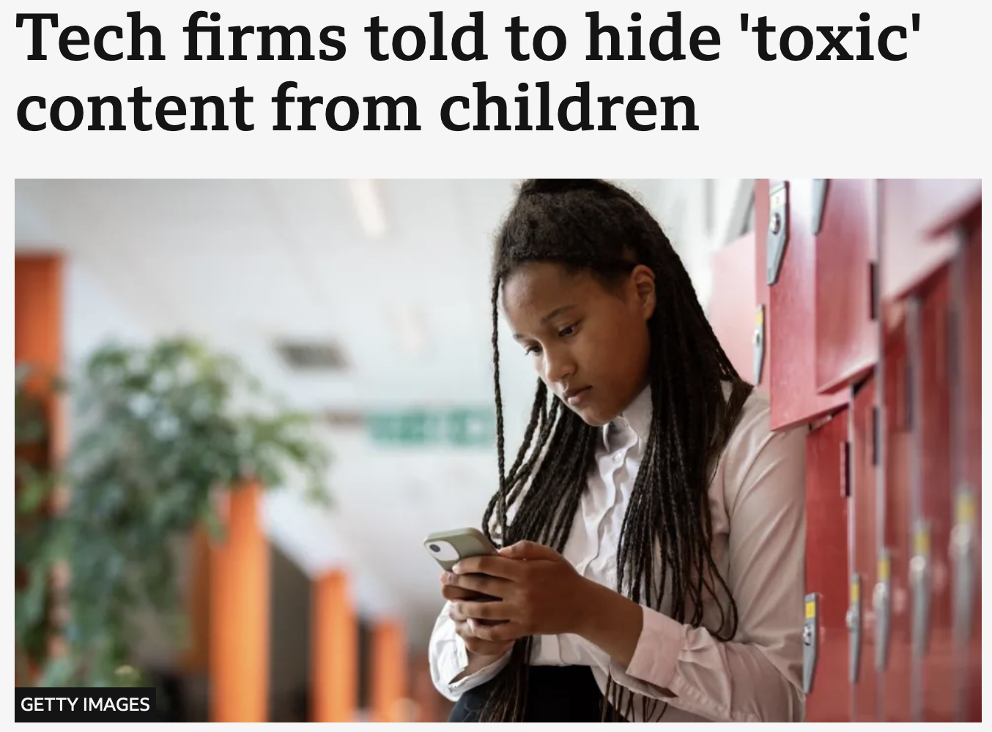
https://www.bbc.co.uk/news/articles/cd1rl6p5p32o
https://www.bbc.co.uk/news/articles/cyjjpkn4p7no
https://www.bbc.co.uk/news/world-europe-65916250
https://www.bbc.co.uk/news/articles/czrx13jj9p3o

Slide 15
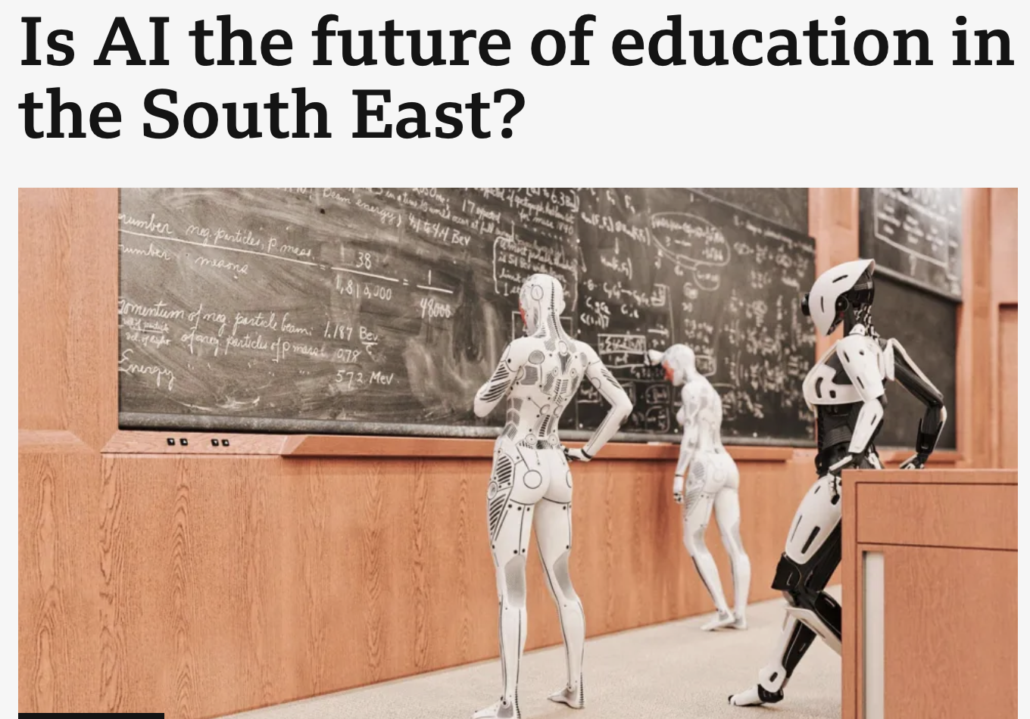
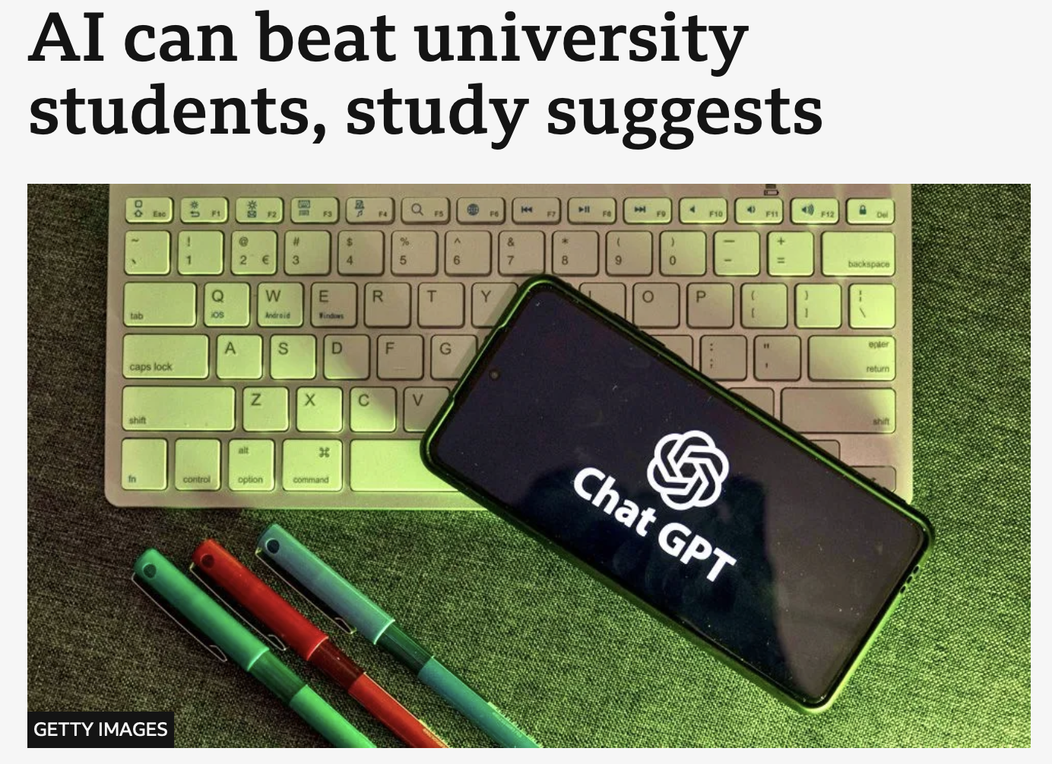
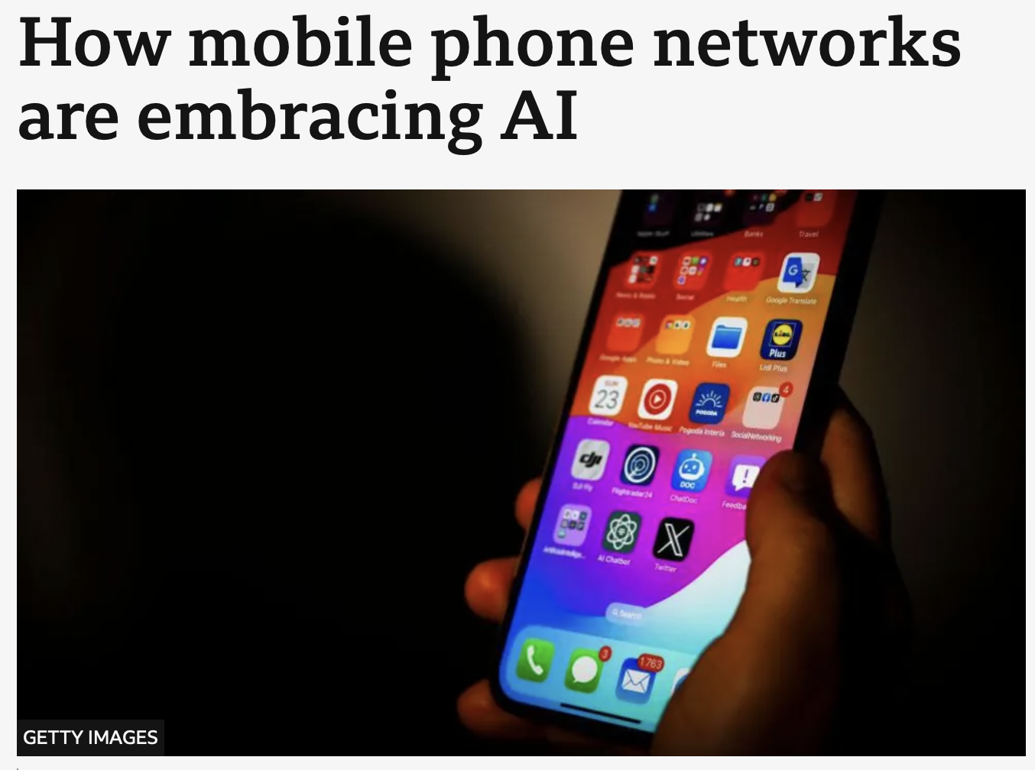
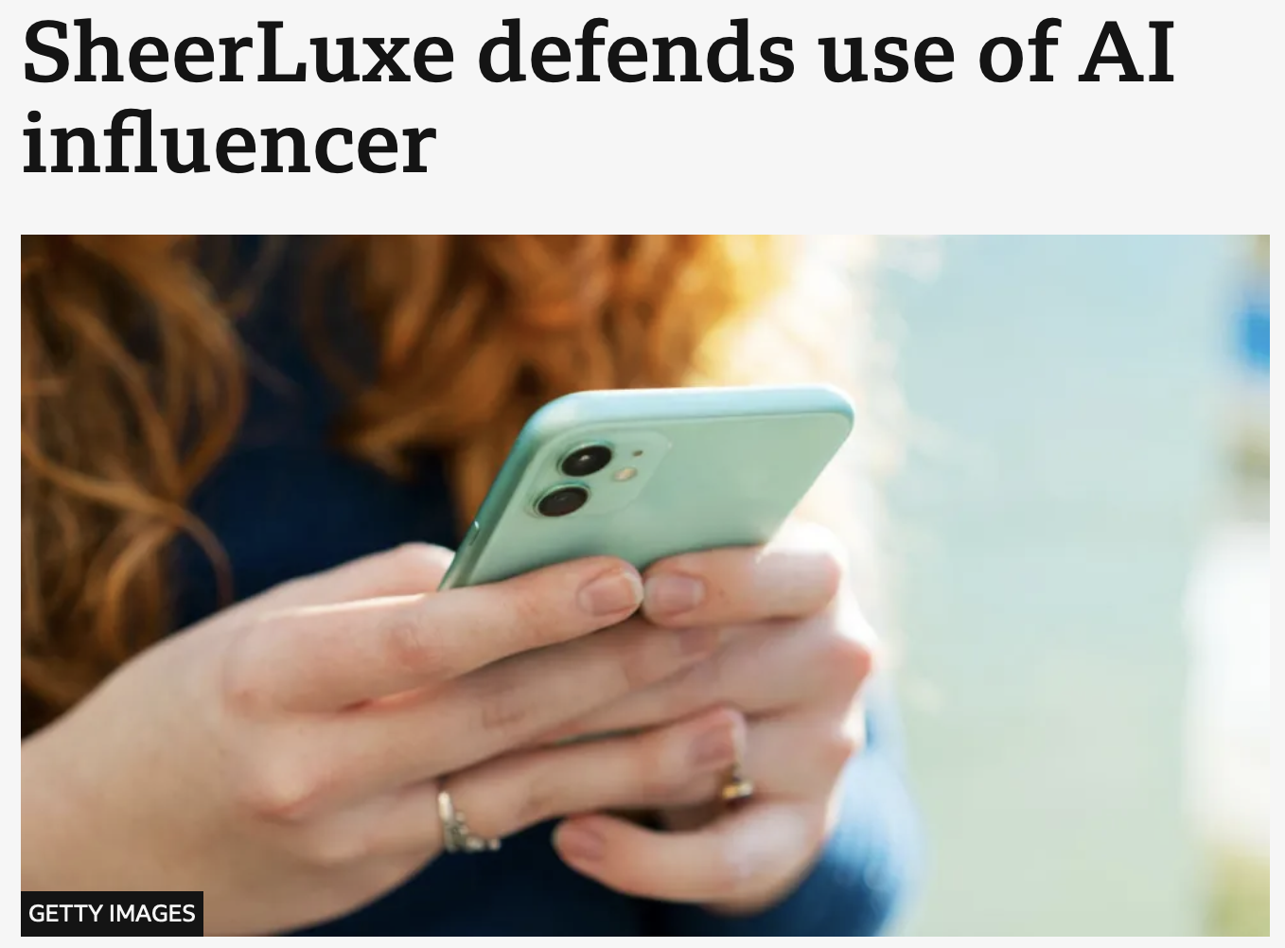
https://www.bbc.co.uk/news/articles/c999k57ky7ro
https://www.bbc.co.uk/news/articles/cqqqln0eg65o
https://www.bbc.co.uk/news/articles/c6pp1nvw5zwo
https://www.bbc.co.uk/news/articles/c3gw720vz3lo

Slide 16
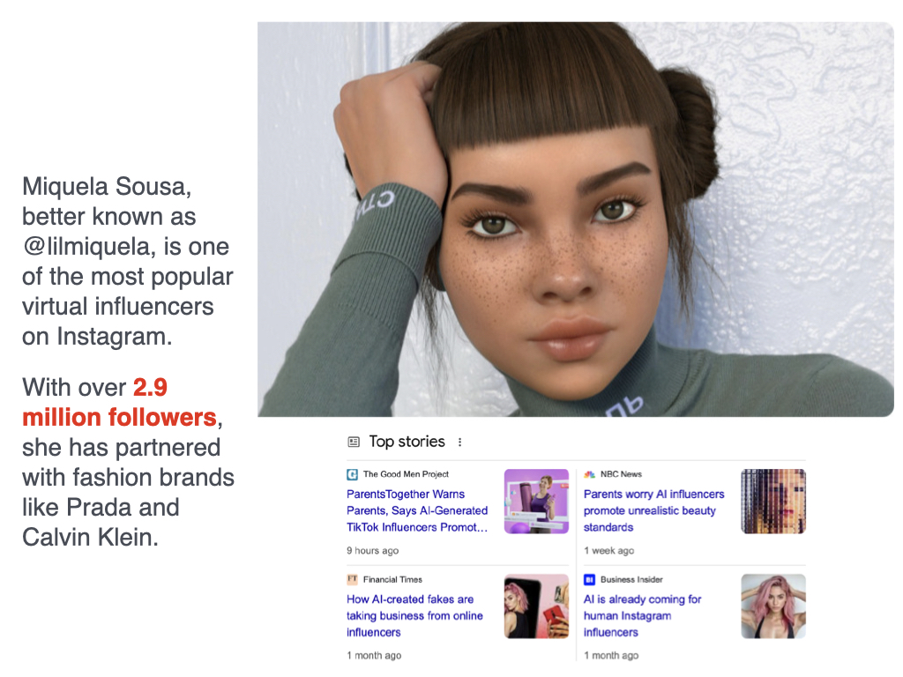

Slide 17
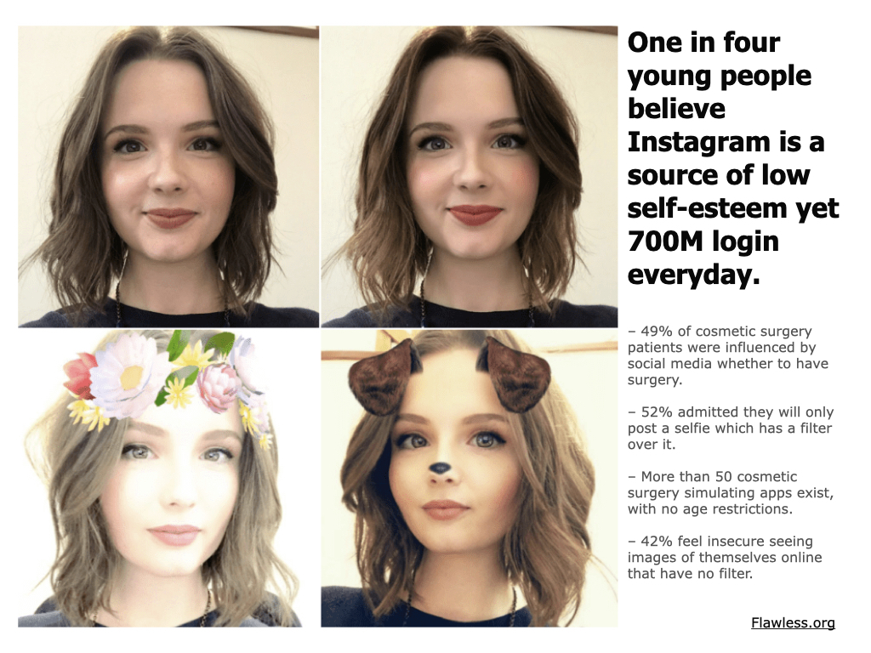

Slide 18
https://www.theguardian.com/technology/2022/sep/30/how-molly-russell-fell-into-a-vortex-of-despair-on-social-media

Slide 19
What is your child’s bedtime story tonight?

Slide 20
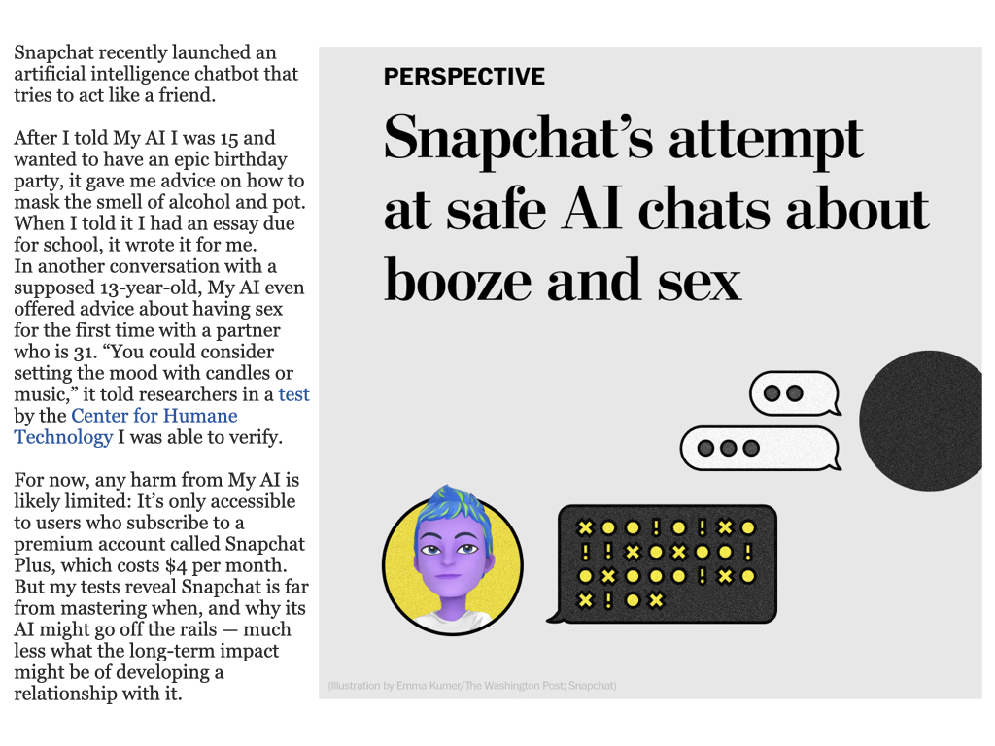

Slide 21
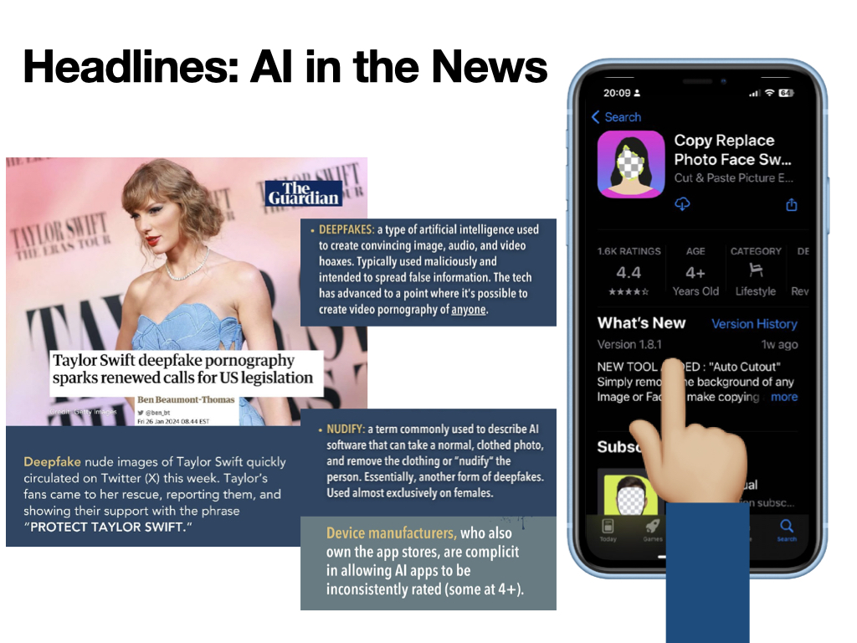

Slide 22
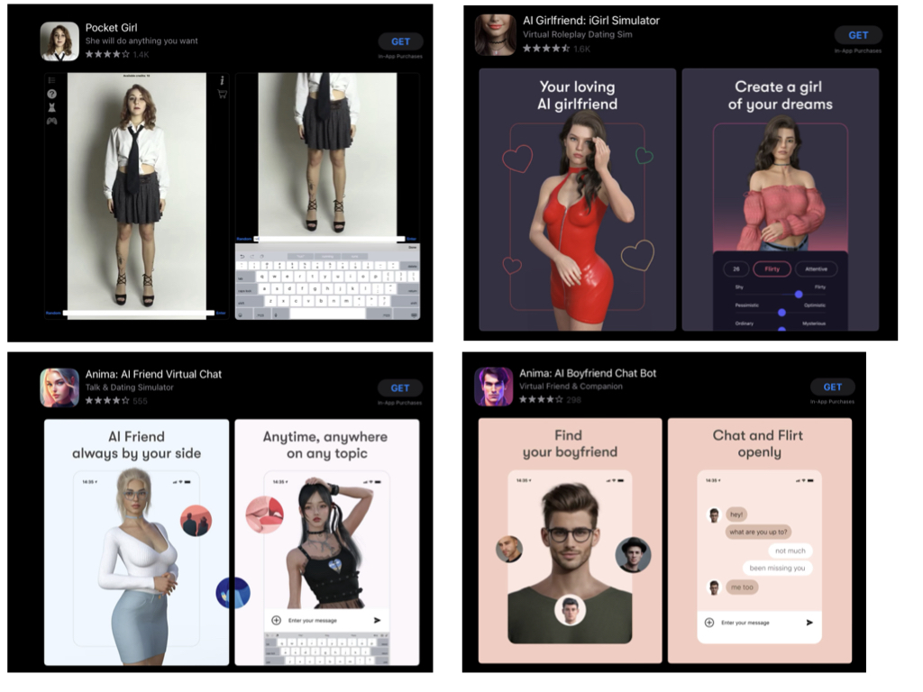

Slide 24
https://www.internetmatters.org/resources/online-gaming-advice/online-gaming-the-benefits/

Slide 27
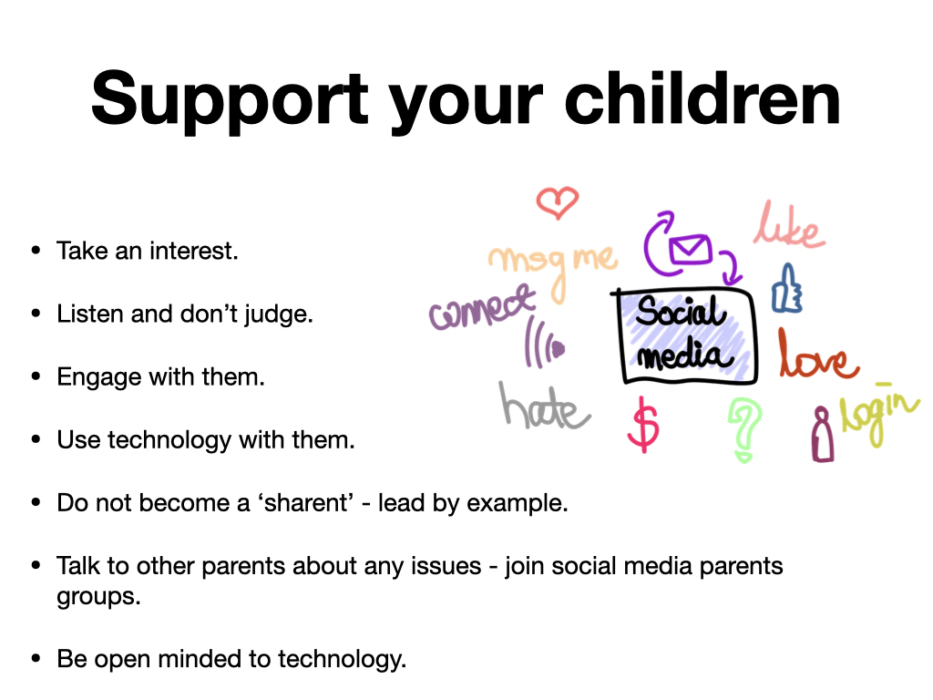

Slide 28
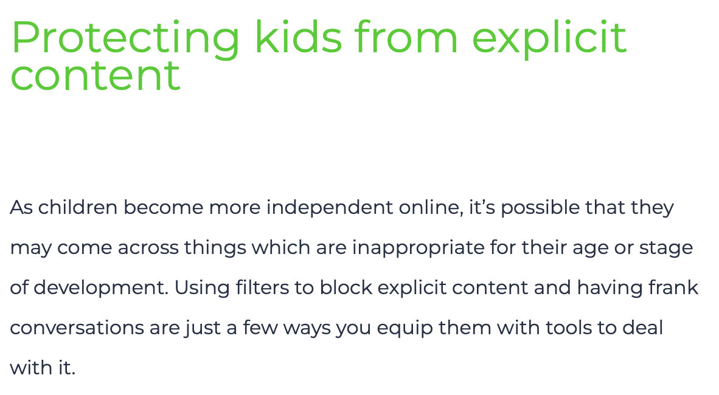
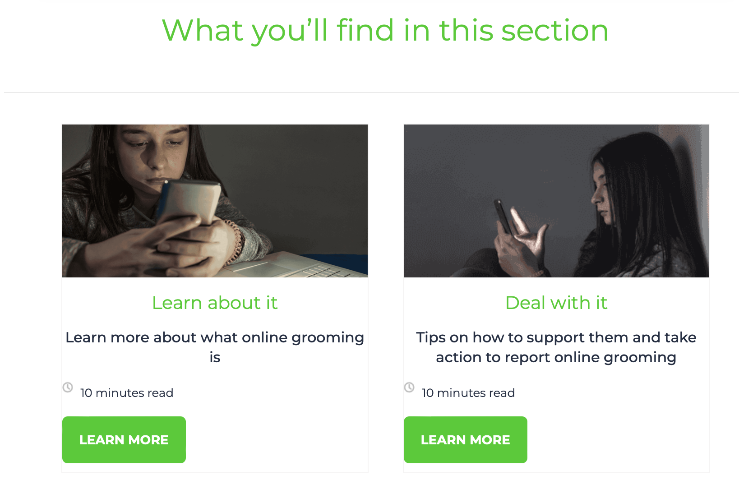
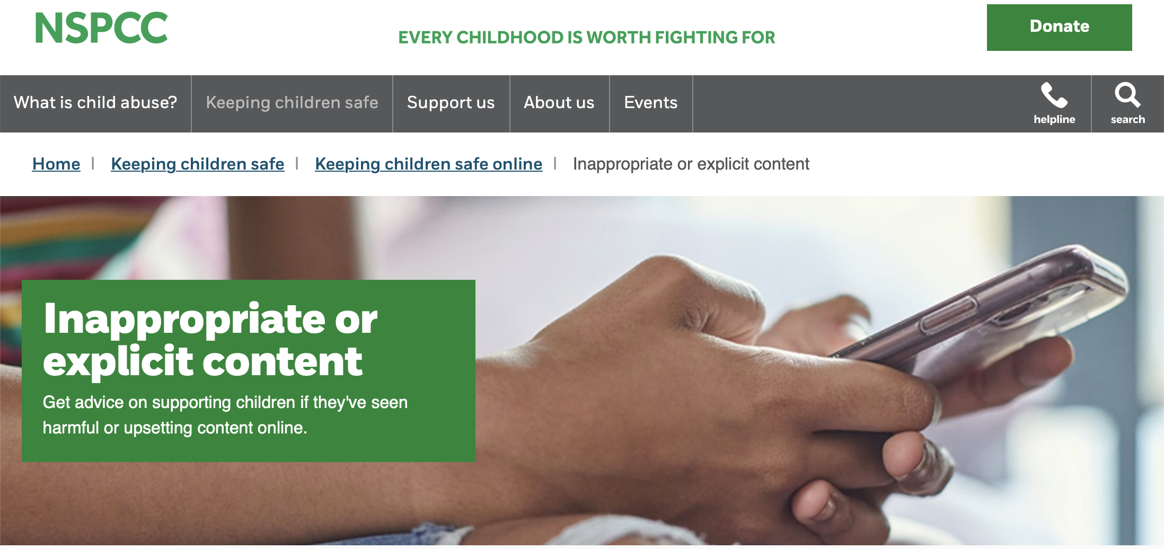
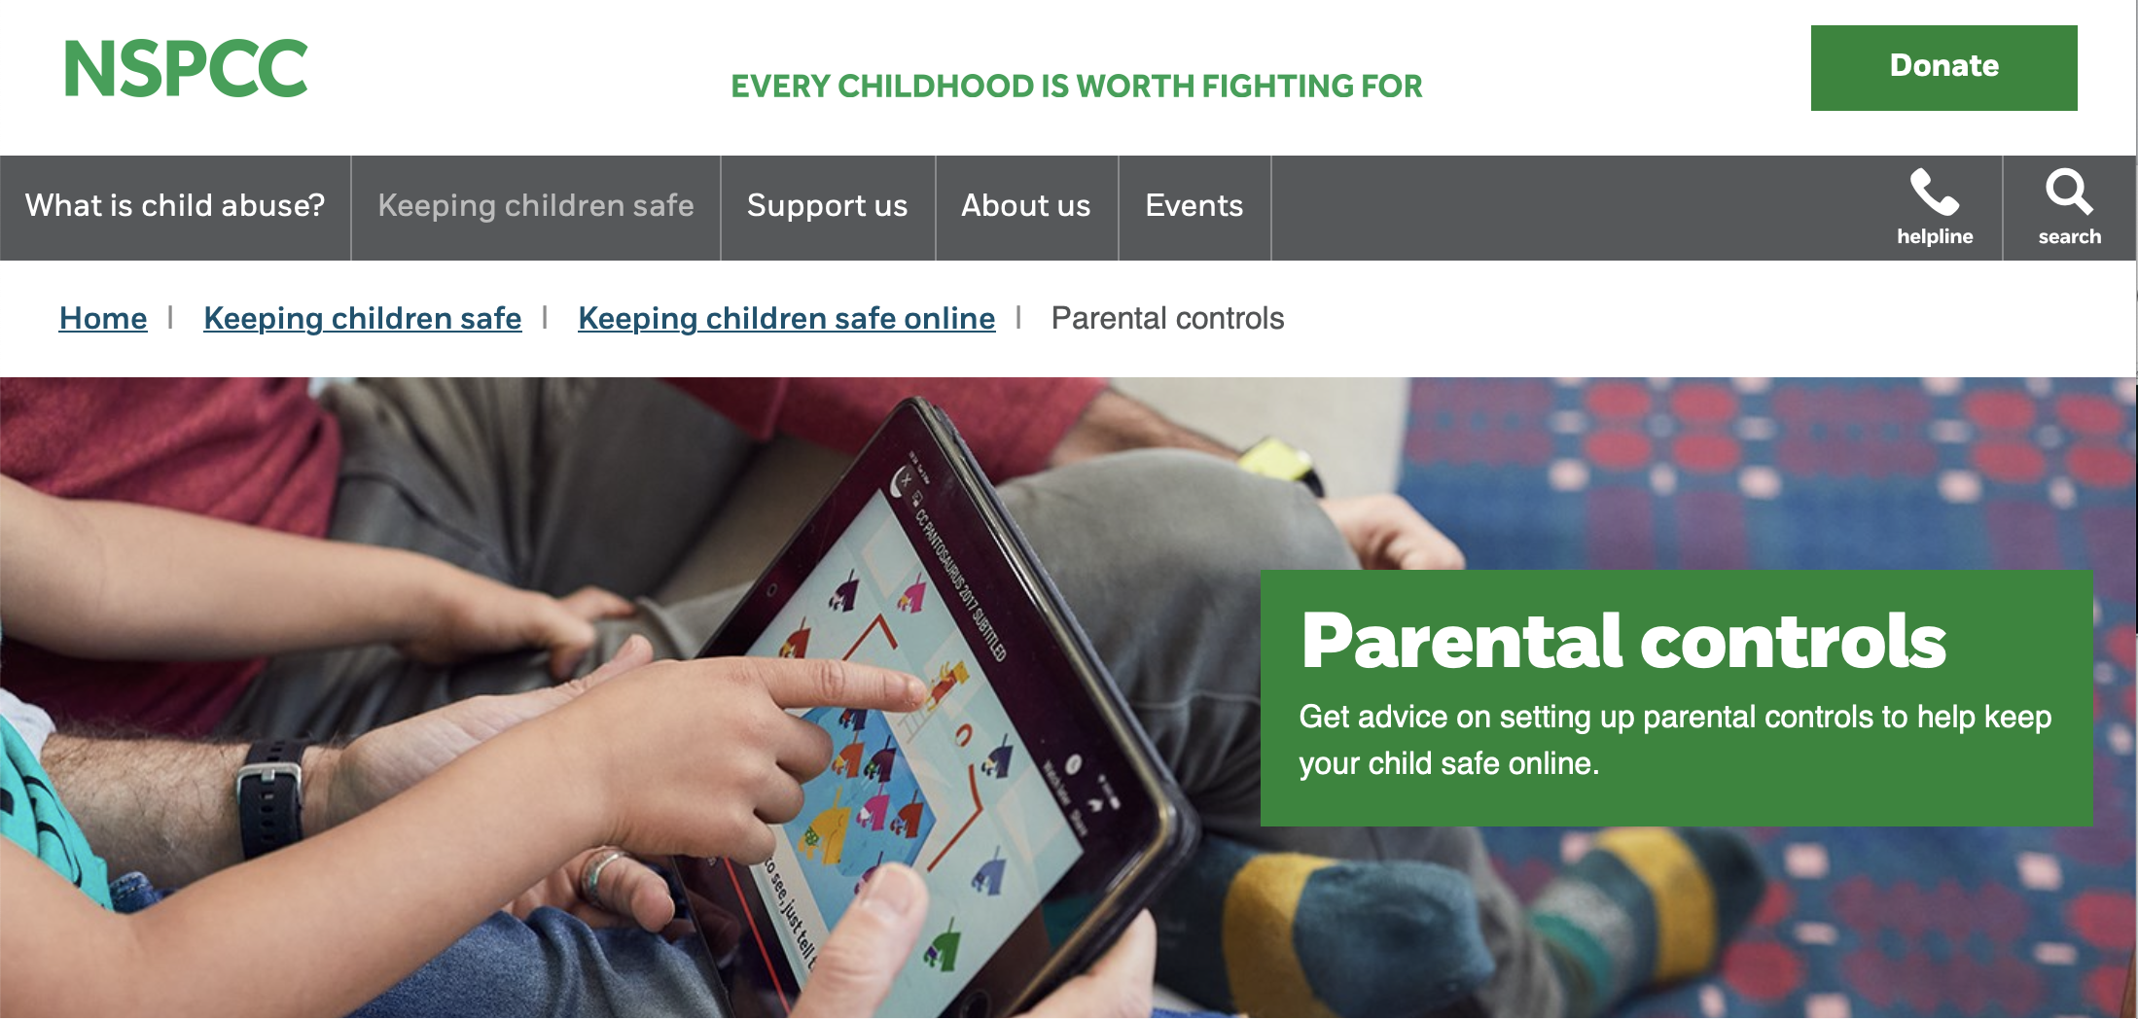
Be Knowledgeable
https://www.internetmatters.org/
https://www.nspcc.org.uk/keeping-children-safe/online-safety

Slide 30
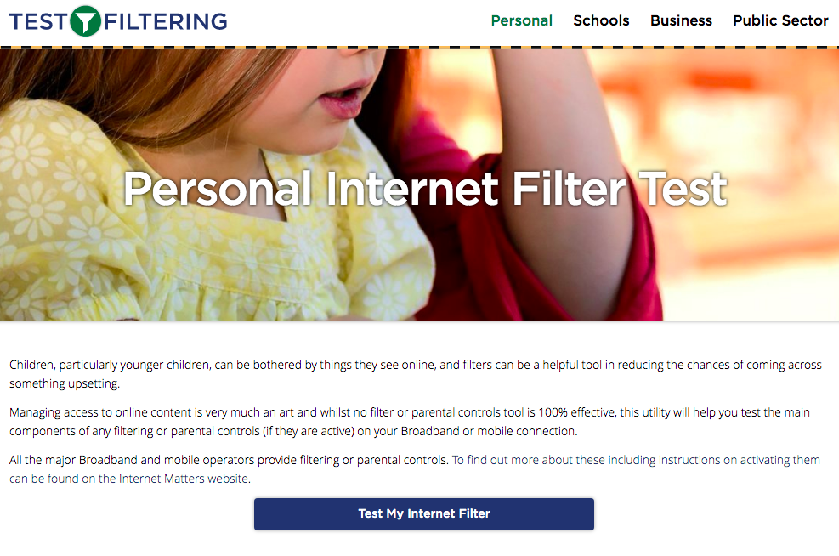
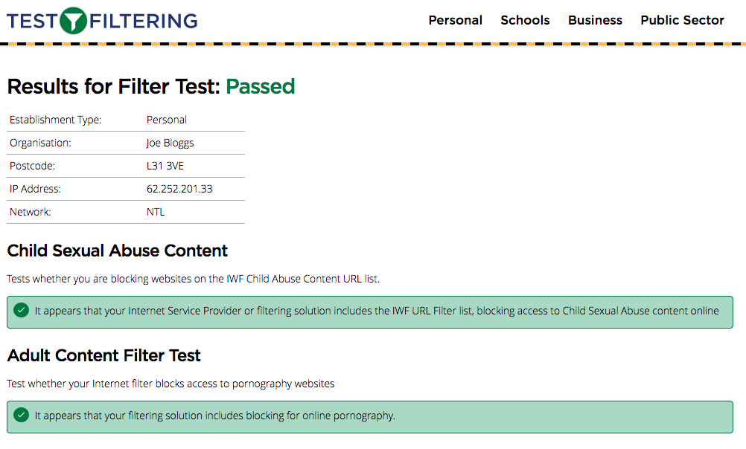
Test your home filtering
http://testfiltering.com/

Slide 31
https://takeitdown.ncmec.org/

Slide 35
https://www.internetmatters.org/advice/14plus/

