Slide 1
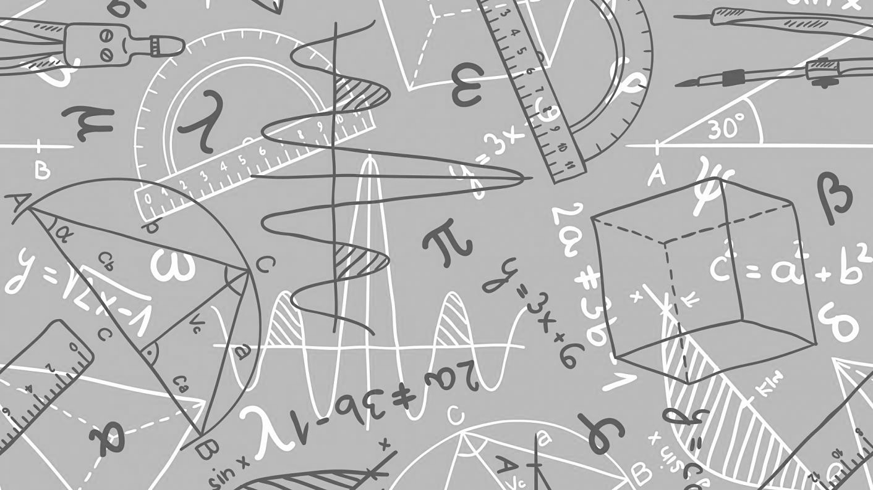
Maths
We can’t wait to meet you…
All the Maths teachers at Clyst Vale Community College are very much looking forward to meeting you. Normally during transition weeks you find out about us, we find out about you and together we do some Maths. Unfortunately due to transition being cancelled we won’t meet in person. However hopefully by completing this booklet you will be able to find out some facts about the Maths teachers at Clyst Vale, do some research into some of our favourite mathematicians and do some maths either on your own or with your family/carers.

Slide 2
Meet the department…
In the Maths department we have 7 Maths Teachers. Our maths corridor looks like this (Dr Turl’s room is the green hut on the maths playground). Throughout this booklet you will find out about some of our favourite Maths related things. Come back to this page to fill those in. Can you find them all?
Favourite Number:
Favourite Mathematician:
Ms Prance
Ma4
Dr Turl
2nd in Department
Ma1
Favourite Number:
Favourite Mathematician:
Favourite Number:
Favourite Mathematician:
Miss Mann
Ma6
Favourite Number:
Favourite Mathematician:
Mr Turnock
Ma3
Mrs Adie
Ma5
Favourite Number:
Favourite Mathematician:
Mr
Newell
Ma7
Favourite Number:
Favourite Mathematician:
Miss BARRATT
Head of Maths
mA8
Favourite Number:
Favourite Mathematician:

Slide 3
The 24 game…
Try this with your family – who is the quickest?
One of our favourite things to do in maths is to play with numbers. The aim of the 24 Game is to be the first person to make the number 24.
For each game you have 4 numbers, you have to use ALL four numbers, you can add, subtract, multiply or divide these to make 24.
Example:
2 2 6 8
To make 24, I can do (8 - 2) x (6 – 2)
8 -2 = 6
6 -2 = 4
6 x 4 = 24
Now it’s your turn, the 24 cards are below they get harder as you go through.
One Dot - Easiest

Slide 4
The 24 game…
Miss Barratt’s favourite number is
99 ÷ 9
two Dot - medium
Mrs Adie is a big fan of Ada Lovelace. This
English mathematician, the daughter of poet
Lord Byron, has been called "the first computer
programmer" for writing an algorithm for a
computing machine in the mid-1800s.
THREE Dot - HARDER

Slide 5
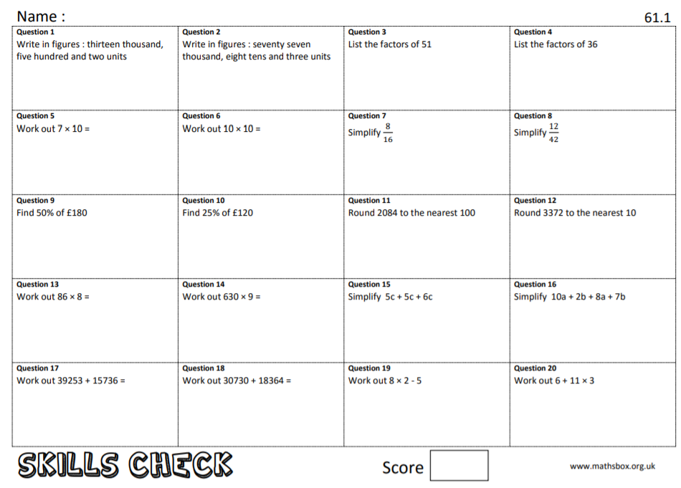
Mrs Adie’s favourite number is is
3 x (5+8)
Key Skills…
When you get to a page like this, spend 10 minutes completing
the skills check questions based on topics from Y6.
Ms Prance’s favourite Mathematician is Fibonacci who was an Italian man who studied math and theories back in the 11th century. He discovered a pattern called the Fibonacci sequence. It's a series of numbers that starts with 0 and 1, and each number after is found by adding the two previous numbers (0, 1, 1, 2, 3, 5…)The sequence just keeps going on and on.
Can you find the first 10 numbers in the sequence?

Slide 6
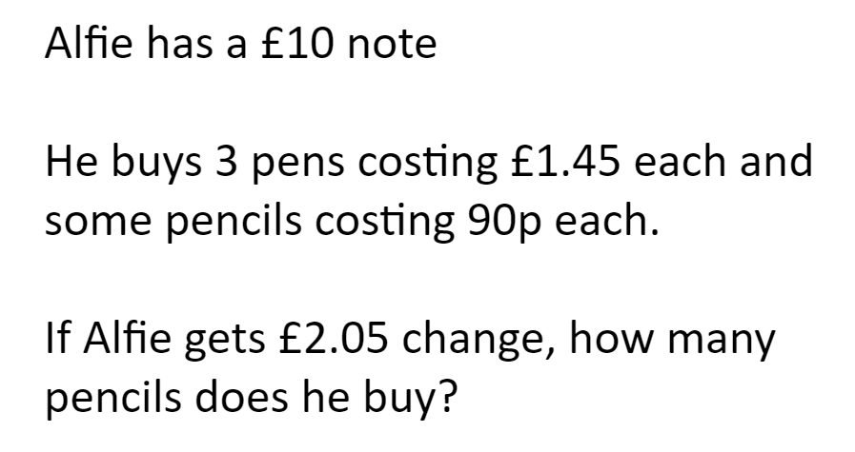
Problem Solving…
At the start of every Maths lesson you will be asked to try and work through a problem solving question. You are not allowed a calculator and you must write down your workings. Now try the question below:
Mr Turnock’s favourite number is
8²
Dr Turl’s favourite mathematician Leonhard Euler (pronounced Oiler) (April 15, 1707 – September 7, 1783) was a Swiss mathematician and physicist. He spent most of his life in Russia and Germany. Euler made important discoveries in fields like calculus and topology. He also made many of the words used in math today.

Slide 7
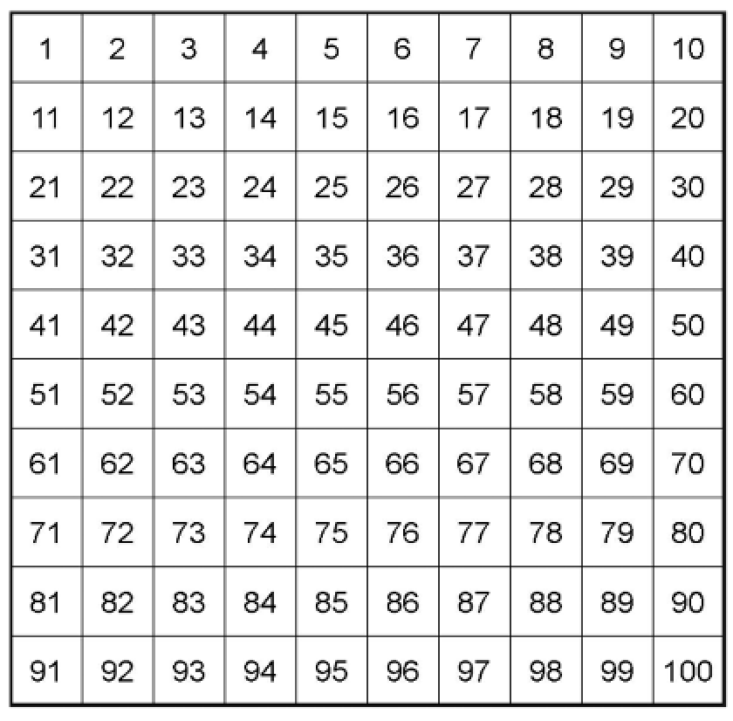
Mr. Newell’s Favourite Number
Mr. Newell is new like you in September. He has hasn’t been to Clyst Vale yet to share his favourite number. Instead he has sent me some clues. Can you work out Mr. Newell’s favourite number?

Slide 8
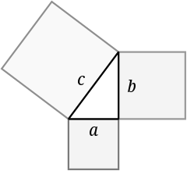
Key Skills…
Miss Mann’s favourite number is 3 + 2 x 7
Pythagoras of Samos was a famous Greek mathematician and philosopher (c. 570 – c. 495 BC). He is known best for the proof of the important Pythagorean theorem, which is about right angled triangles. He started a group of mathematicians, called the Pythagoreans, who worshiped numbers and lived like monks.
Can you find out what the Pythagorean theorem is? You will use it in Year 9.
This mathematician is Miss Barratt’s favourite.
Dr Turl’s favourite number is 2³

Slide 9
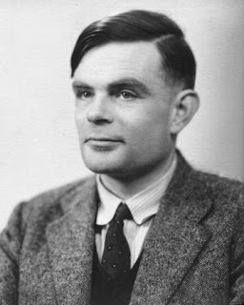
Ms Prance’s favourite number is $\sqrt{25}$ (the square root of 25)
Code Breaking…
Alan Turing
Alan Turing was a British mathematician. He made major contributions to the fields of mathematics, computer science, and artificial intelligence. He worked for the British government during World War II, when he succeeded in breaking the secret code Germany used to communicate.
In September 1939 Great Britain went to war against Germany. During the war, Turing worked at the Government Code and Cypher School at Bletchley Park. Turing and others designed a code-breaking machine known as the Bombe. They used the Bombe to learn German military secrets. By early 1942 the code breakers at Bletchley Park were decoding about 39,000 messages a month. At the end of the war, Turing was made an Officer of the Most Excellent Order of the British Empire.
Can you crack the code to reveal the 3 Maths teachers who’s favourite mathematician is Turing?
A | B | C | D | E | F | G | H | I | J | K | L | M
55 | 47 | 84 | 10 | 9 | 75 | 59 | 64 | 32 | 15 | 23 | 50 | 26
N | O | P | Q | R | S | T | U | V | W | X | Y | Z
80 | 63 | 19 | 3 | 27 | 30 | 21 | 92 | 18 | 35 | 99 | 69 | 199
3 x 7 =
100 – 8 =
3 x 3 x 3 =
800 ÷ 10
9 x 7
9² + 3 =
5 x 5 – 2 =
1 + 5² =
11 x 5 =
4 x 2 x 10 =
100 – 4x5 =
9² - 1 =
3² =
5 x 7 =
5 x 2 – 1 =
25 x 2 =
200 ÷ 4 =
Can you make up some calculations to spell out your name using the same code breaker grid?

Slide 10
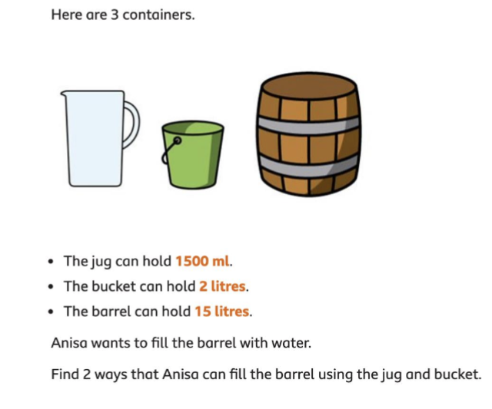
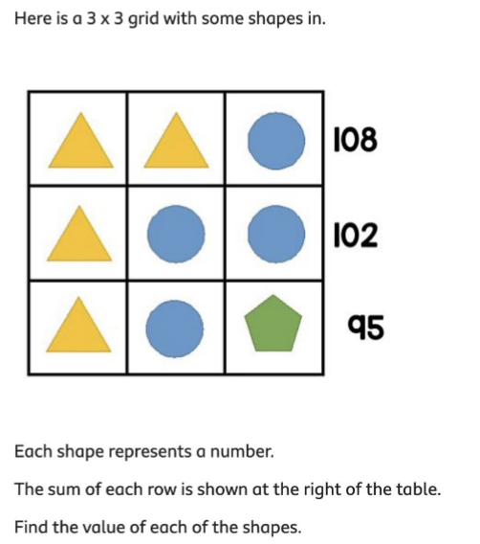
Maths Challenges…
Can you solve all the Maths challenges?
They get more difficult as you get them..

Slide 11
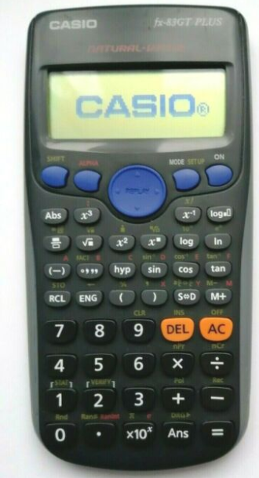
Maths Equipment
All students will need the following equipment in every lesson:
2 x black pens
2 x pencils
1 x red pen
1 x highlighter
1 x ruler
1 x rubber
A pair of compasses
A protractor
A scientific calculator-we recommend the CASIO 83/85 calculator

